Slide 1

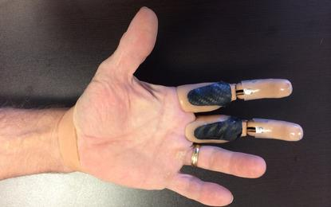
Biomechanical Model of a Finger Fabricated Using Torsional Artificial Muscles
Diego Higueras Ruiz
Sam Sarkar
Siwoo Jeong

Slide 2
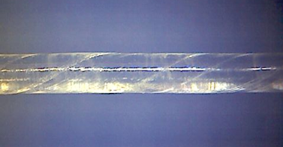
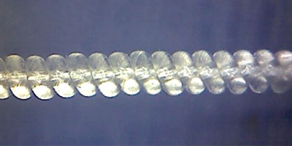
STPA vs TPA

Slide 3
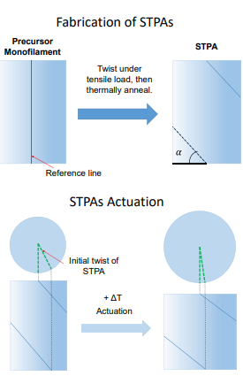
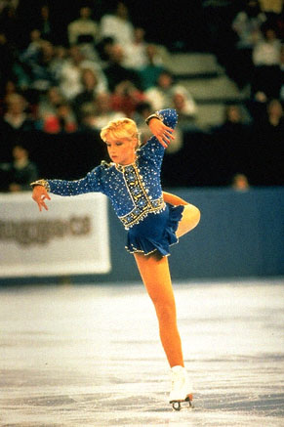
STPA
Straight twisted polymer actuators (STPAs)
Twisted Polymer monofilament
Nylon fishing line
Thin, light, cheap!
The mechanism of untwisting actuation
Linear actuator
Untwisting due to an asymmetric thermal expansion
Radial expansion & axial contraction

Slide 4
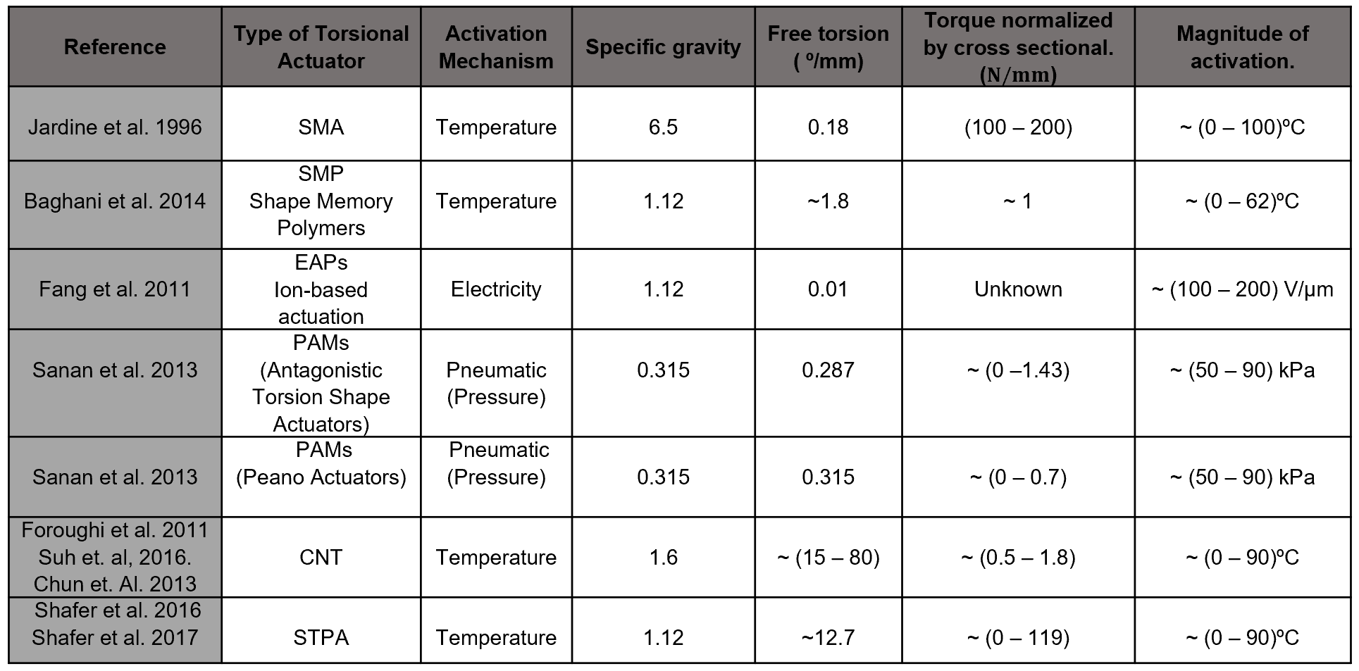

Slide 5
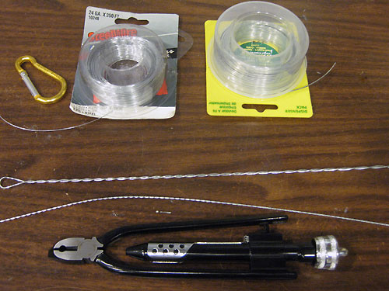
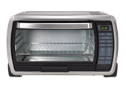
Fabrication
Annealing at 120°C for
20 minutes and cooled down
to room temperature

Slide 6
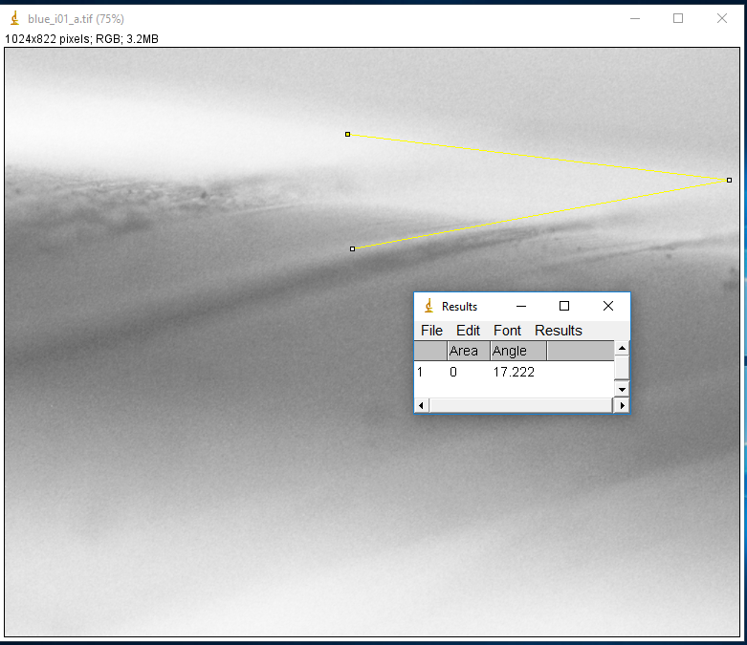
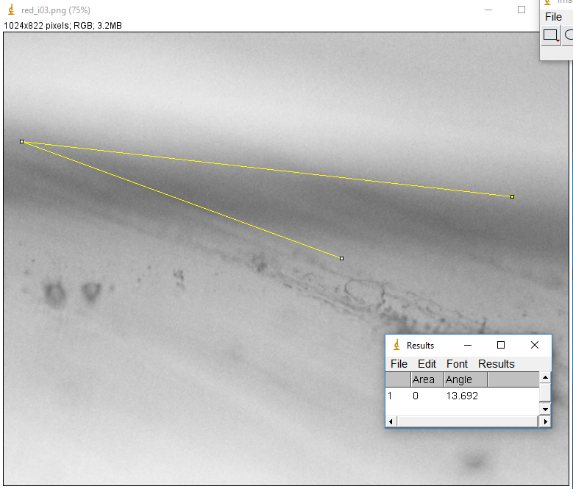
Microscope Images

Slide 7
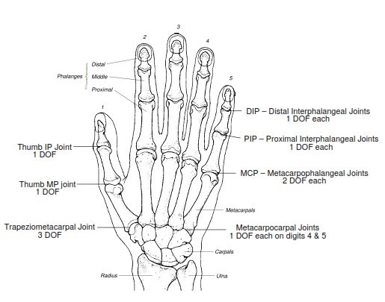
INTRODUCTION
Human Hand
A very sophisticated means for physical and social interaction
23 DoFs for the hand and 6 for the Wrist
Hand loss
Around 541,000 Americans (Ziegler-Graham et al., 2008)
A devastating damage
Limiting the capability of performing ADLs

Slide 8
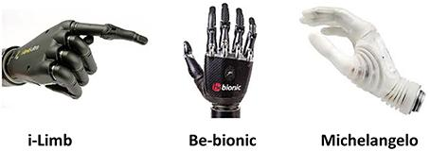
INTRODUCTION
Hand prosthesis
Passive prostheses
Cosmetic or functional prostheses
Active prostheses
Externally powered
Engineering Challenges in the development of prosthetic devices
Size and weight of the replaced hand (Cordella et al., 2016)
Control of prosthesis that notably affects functionality (Gonzales & Castellini, 2013; Wininger et al., 2008)

Slide 9
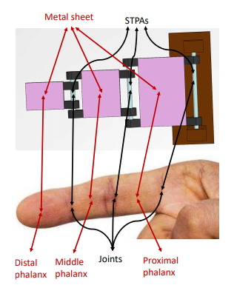
INTRODUCTION
Our Question
“Can a finger model made of STPAs be a candidate to substitute a human finger?”
Light weight and cheap!!!
In this study, as the first step
The relationship between the temperature and the joint angle
The relationship between the temperature and the joint torque

Slide 10
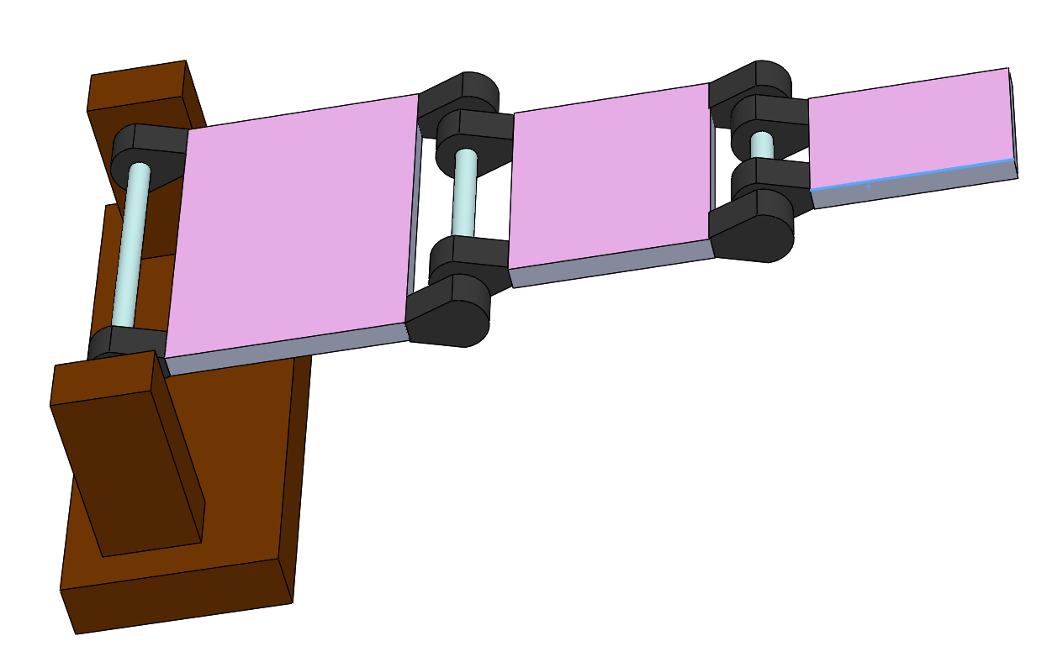
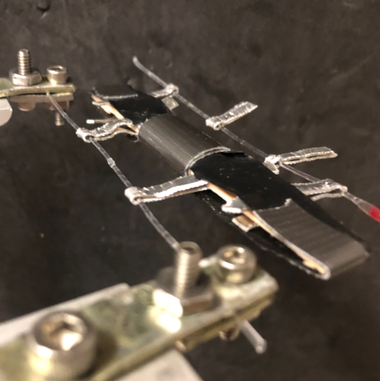
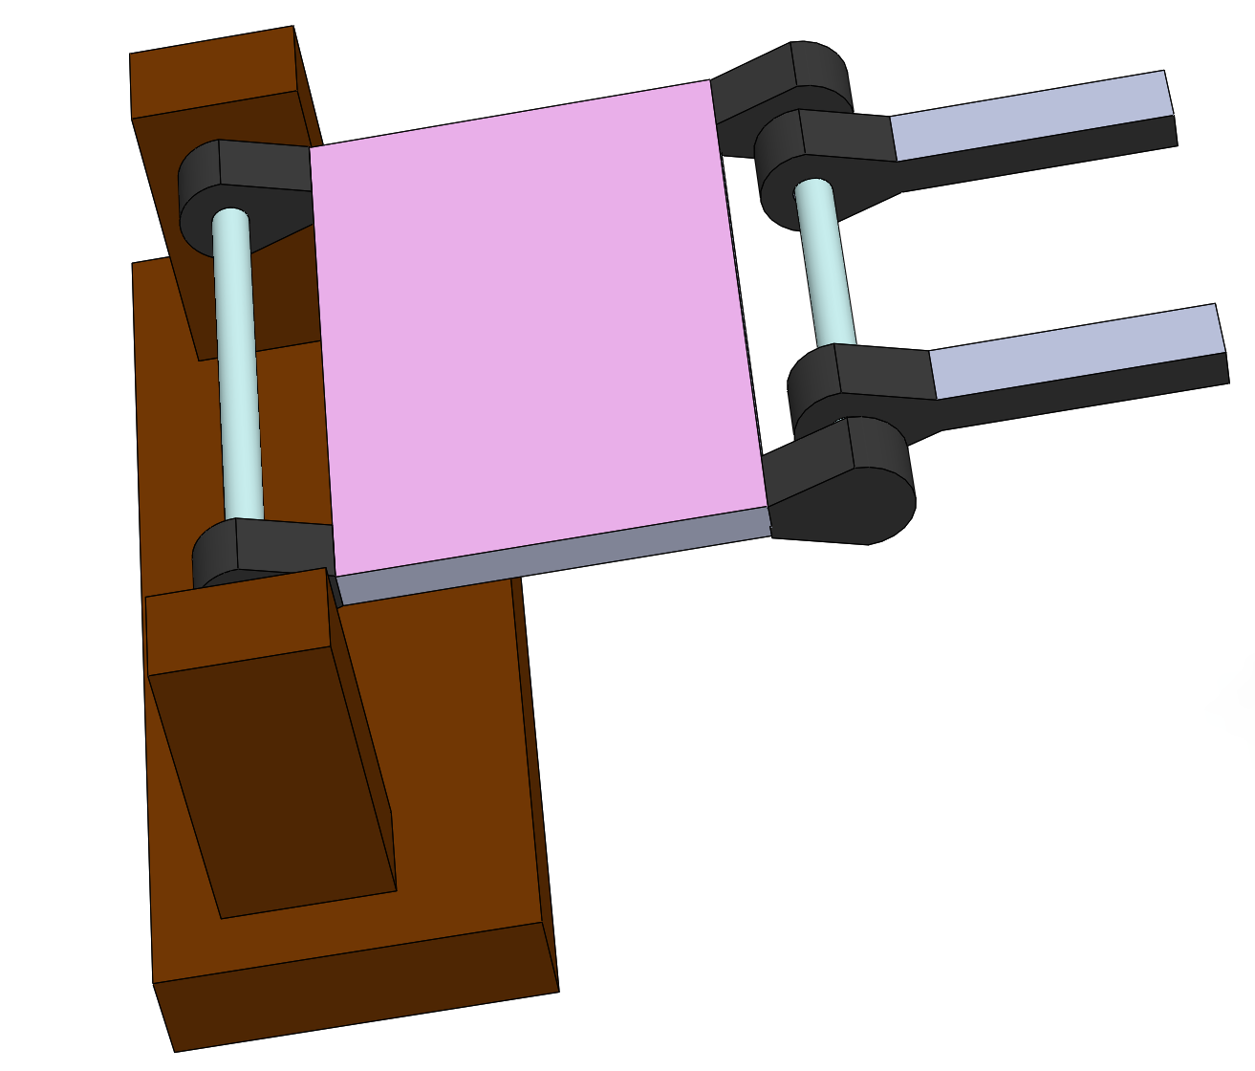
SolidWorks Model. Problem Statement

Slide 11
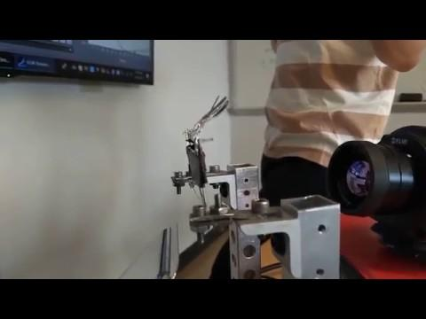
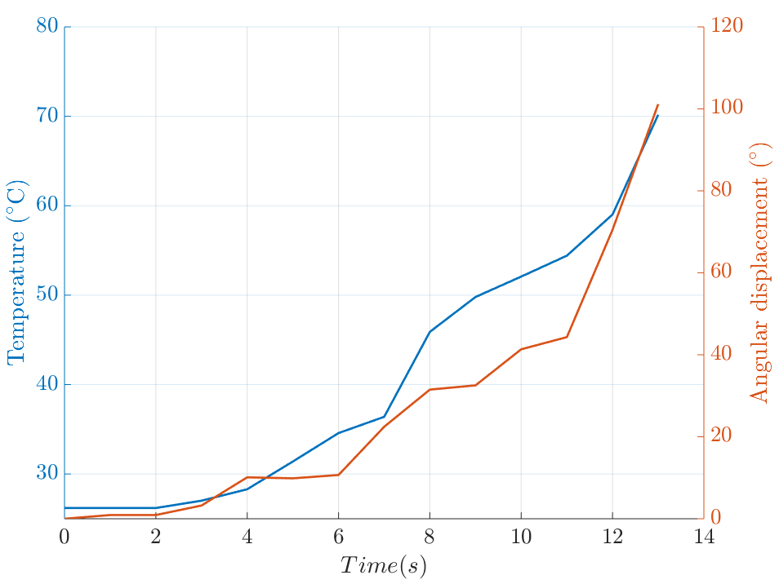
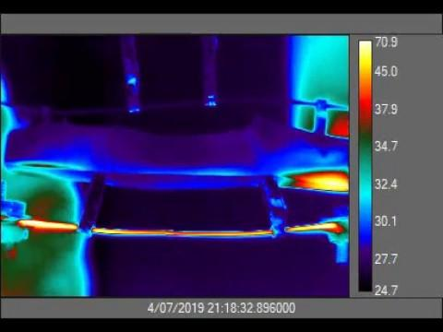
Experimental Results. Lower Torsional Actuator Joint
Angular displacement and temperature vs. time of the Lower Torsional Actuator Joint.

Slide 12
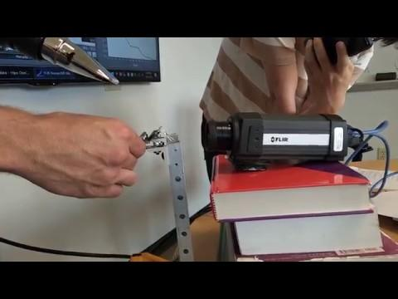
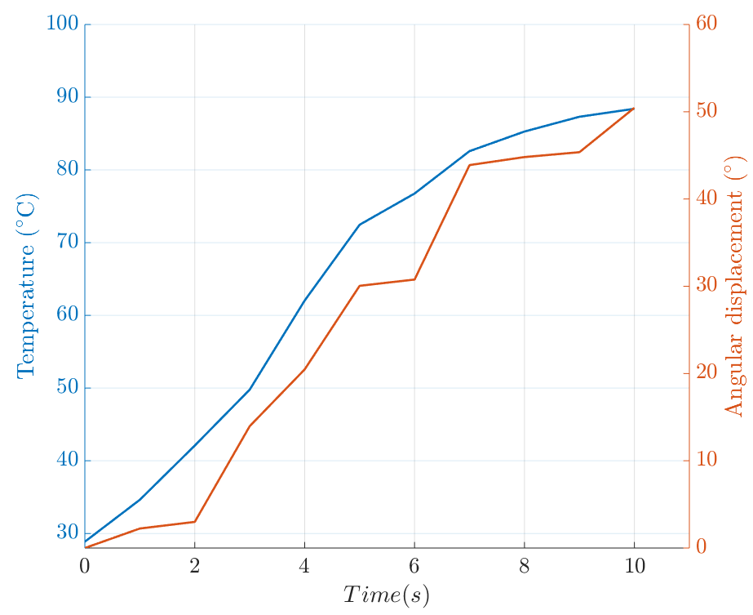
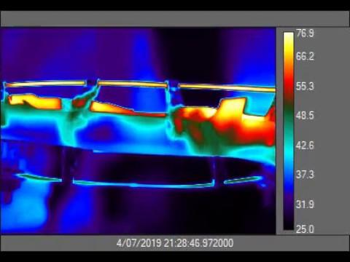
Experimental Results. Upper Torsional Actuator Joint
Angular displacement and temperature vs. time of the Upper Torsional Actuator Joint.

Slide 13
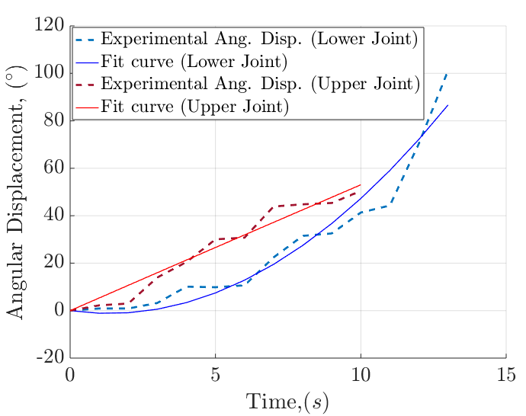
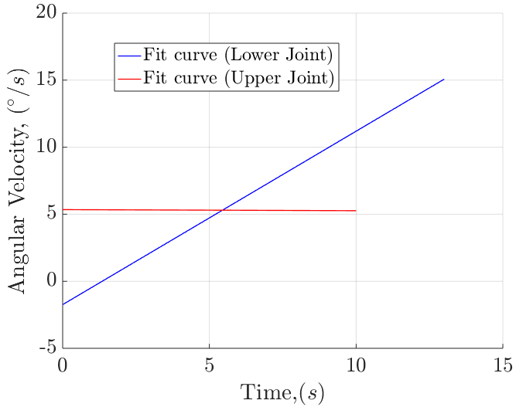
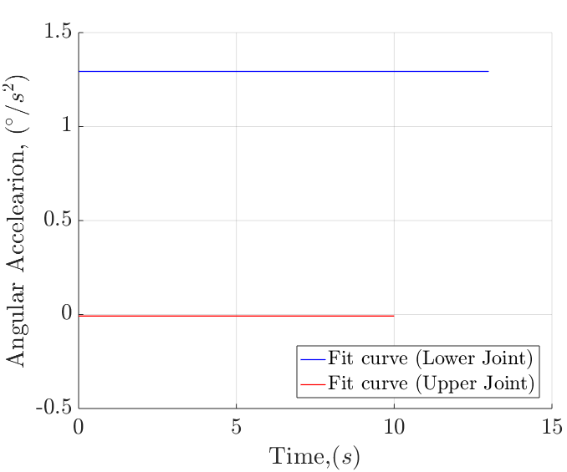
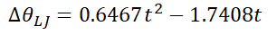
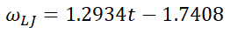
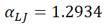
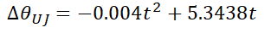
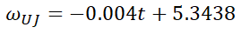
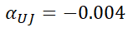
Angular Displacement, Velocity, and Acceleration for the Lower and Upper Joint
Angular displacement vs. time of the upper and lower Torsional actuator joint along with curves fit.
Angular velocity vs. time of the upper and lower torsional actuator joint.
Angular acceleration vs. time of the upper and lower torsional actuator joint.

Slide 14
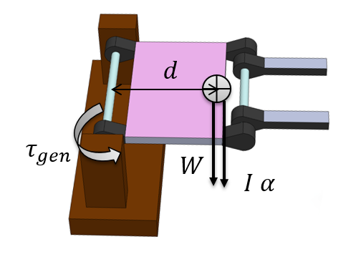
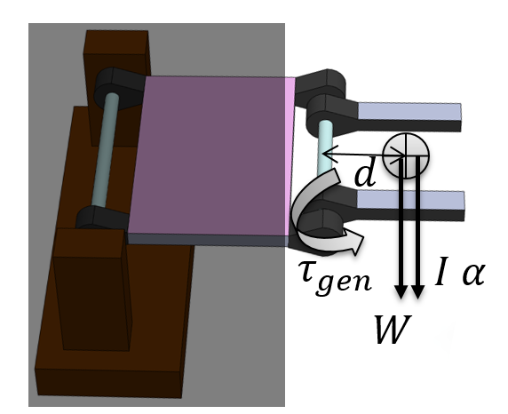
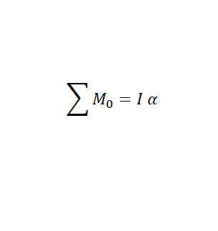
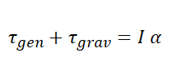
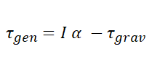

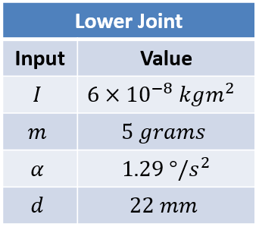
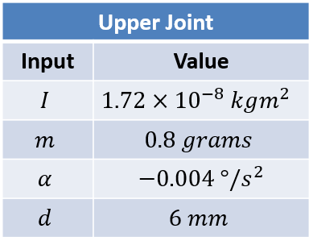
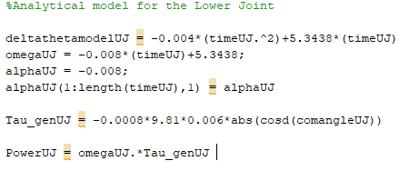
Dynamic Analysis
Lower Torsional Actuator
Upper Torsional Actuator
Matlab code

Slide 15
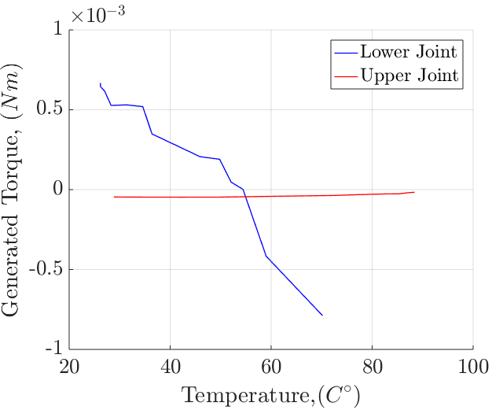
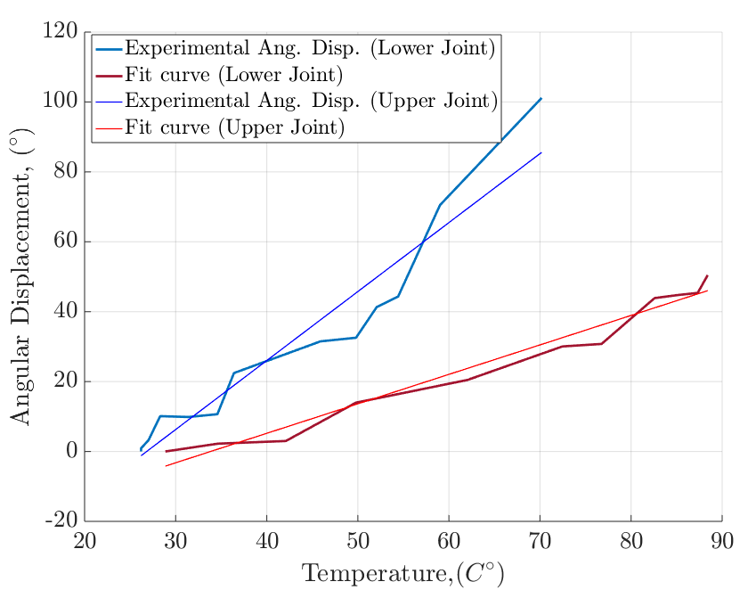
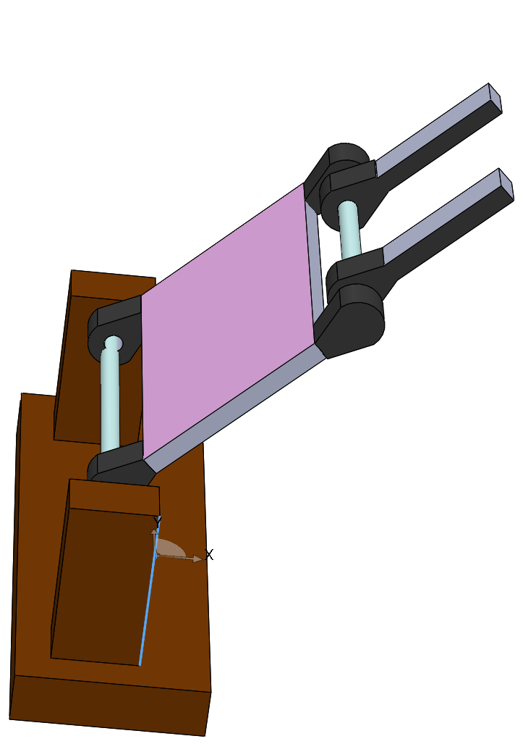
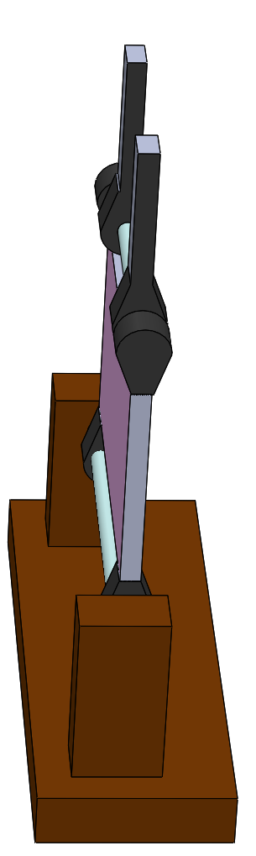
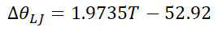
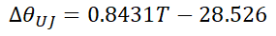
Torque and displacement as a function of temperature

Slide 16
Conclusions
STPA is a suitable candidate material for artificial fingers
Specific Torque generated by STPA is 19.3 kNm/m3 which is in the same order of magnitude as that of a real human finger under blocked torque conditions (95.5 kNm/m3) [5]
Further research is needed to (among other things) increase the total torque generated.

Slide 17
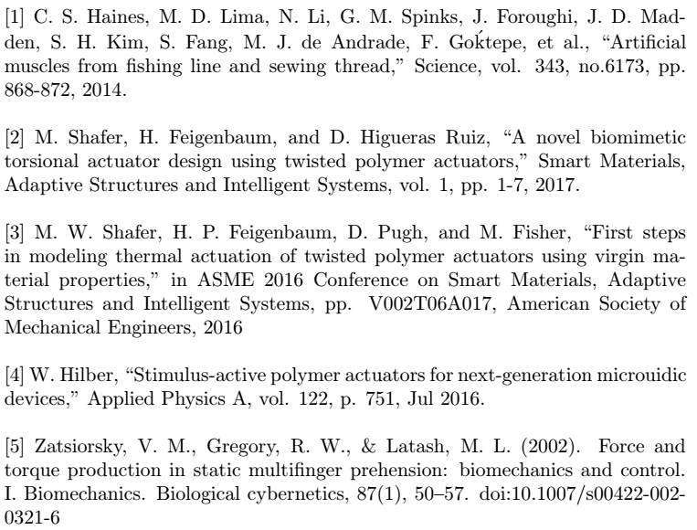
References

Slide 18
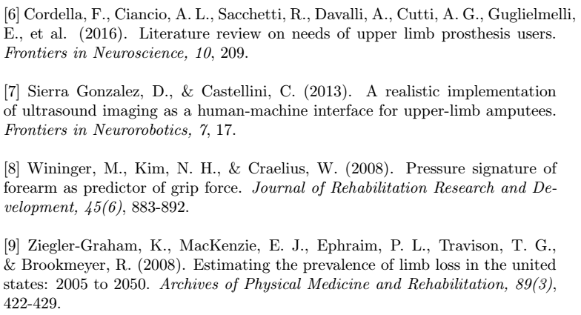
References… contd.

Slide 19
DEMO

Slide 20
Questions?

Slide 21
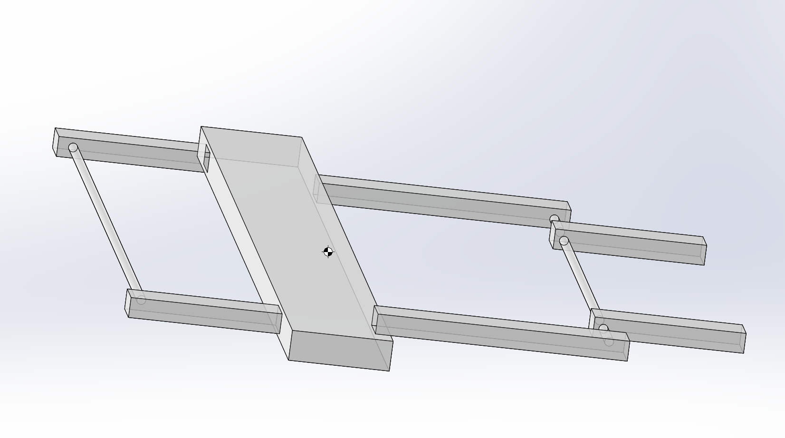
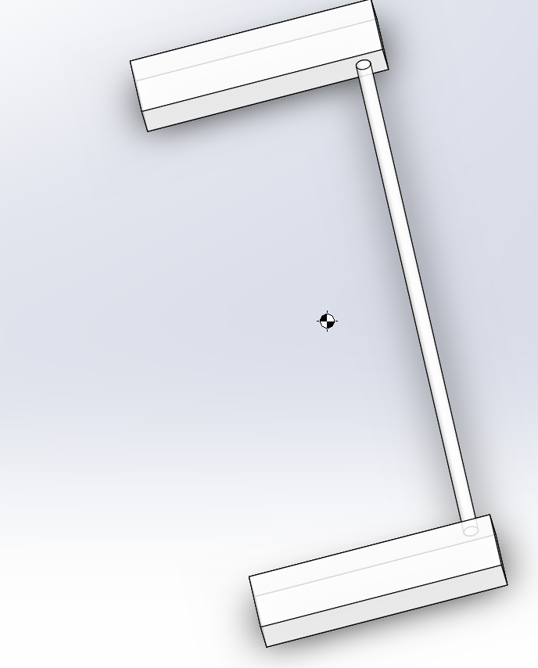
Back-up slides

Slide 22
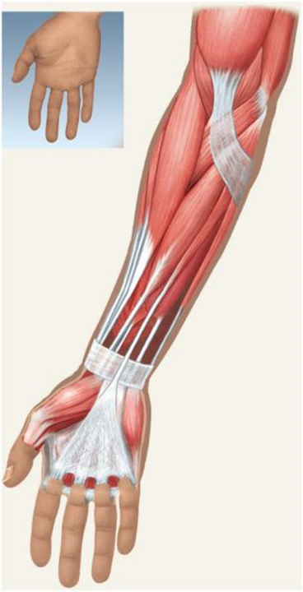

INTRODUCTION
Flexor Digitorum Superficialis:
•Origin: medial epicondyle of humerus, and proximal ulna & radius
•Insertion: middle phalanges of 2 – 5 digits
•Action: flexes digits 2-5 and flexes hand
Extensor Digitorum
•Origin: lateral epicondyle of humerus
•Insertion: middle & distal phalanges of 2–5 digits
•Action: extends digits 2-5 and flexes hand

